Slide 1
P1P1
Example questions types

Slide 2

P1P1 – information...
20% of module
1 hr 15 minutes
20 questions
Online assessment – QuestionMark
Monday 26th October 13.00 (1st and 2nd floor labs in ECS1)

Slide 3
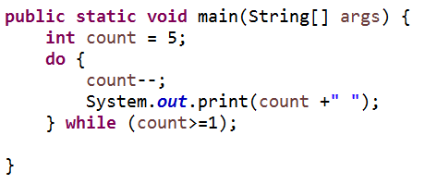
What is the output ?
A B C D
5 4 3 2
4 3 2 1
5 4 3 2 1 0
4 3 2 1 0
Notes:
D

Slide 4
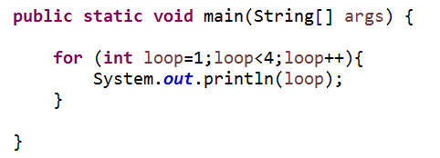
What is the output ?
A B C D
Notes:
A

Slide 5

Loops…
Which statement is Java enables the current iteration to be skipped but the loop to carry on thereafter ?
Notes:
continue;

Slide 6
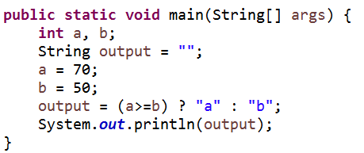
What is the output ?
Notes:
a

Slide 7

Binary
What is +25 as a signed 8 bit Two’s complement number
What is -25 as a signed 8 bit Two’s complement number
Notes:
+25 00011001
-25 11100111

Slide 8

Binary addition
What is the results of the following Signed Two’s complement addition
00110011
+ 00001111 __________
Notes:
00110011 (51)
+ 00001111 (15) ___________
01000010 (+66)

Slide 9
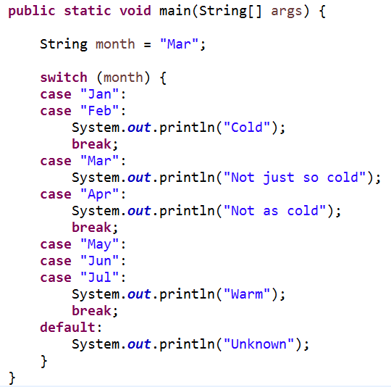
Switch
What is the output ?
Notes:
Not just so cold
Not as cold

Slide 10
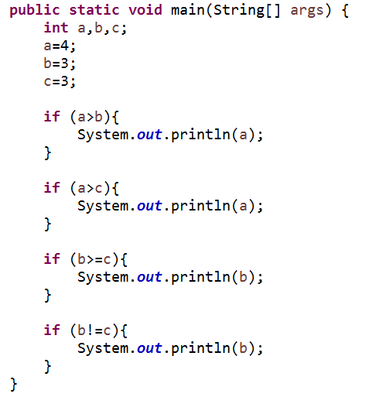
Relational operators - what is the output ?
Notes:
4
4
3

Slide 11

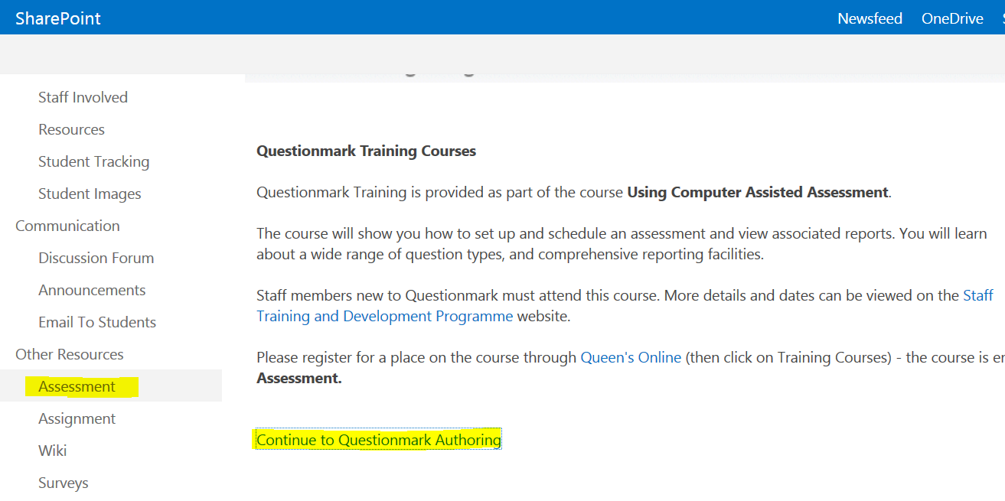
Getting access to Question Mark via QOL – check it out now !
Internet Explorer only !

